Slide 1

Capstone Project on
E-Commerce
Analysis
Comprehensive Data Analysis and Modeling
by Divyashree S N

Slide 2
Introduction
Project Overview: Analyze an e-commerce
platform's performance.
Objectives: Understand customer behavior, sales patterns, and
predict future sales.
Deliverables: Insights, predictive models,
and actionable recommendations.

Slide 3
E-COMMERCE overview
E-commerce (electronic commerce) refers to the buying and selling of goods or services, as well as the transfer of money and data, over the internet.
Key Features:
•Online marketplace accessible 24/7
•Digital payment methods
•Reduced geographical barriers

Slide 4
Key Steps
• Phase 1: Understanding and Preparing the data
Part A: Initial Data Exploration
Part B: Data Integration
• Phase 2: Data Cleaning and Feature Engineering
• Phase 3: Exploratory Data Analysis (EDA)
• Phase 4: Statistical Analysis and Modeling

Slide 5
Dataset Description
• Dataset Components:
Orders, Customers, Order items, Products, Reviews, Payments, etc.
• Key Relationships:
Orders.customer_id ↔Customers.customer_id
Products.product_id ↔ Order Items.product_id
• Data Dictionary:
Comprehensive descriptions of each column.

Slide 6
Phase 1: Understanding and Preparing the data
Part A: Initial Data Exploration
Objective: Understand the structure and content of the dataset.
1. Data Loading and Overview
Loaded datasets: orders, customers, products, geolocation, order_items, order_payments,
order_reviews, sellers, and product_category.
Data Structure:
Example Columns:
Orders: order_id, customer_id, order_status, order_purchase_timestamp.
Products: product_id, product_category_name, product_weight_g.
Data Dictionary Created:
Documented the purpose and details of each column (e.g., order_id: Unique identifier for each order).
Relationships Between Tables:
Example: orders.customer_id → customers.customer_id (1-to-many).

Slide 7

Key Relationships

Slide 8
2. Data Quality Assessment
Objective: Assess and clean the data.
Missing Values Identified:
Example: order_delivered_customer_date (3229 missing), price (775 missing).
Duplicates:
Example: Found 261,831 duplicates in geolocation.
Data Types:
Ensured consistency, e.g., converted order_purchase_timestamp to datetime.
Outliers:
Identified potential outliers in numeric fields using IQR.
Anomalies Documented:
Example : Missing order_delivered_customer_date for orders in transit.

Slide 9
3. Data Integration - Planning
Objective: Develop a strategy to combine relevant tables.
Relevant Tables for Analysis:
Key Tables: orders, order_items, customers, products, order_reviews.
Supplementary Tables: geolocation, sellers, order_payments.
Join Strategy:
Example Joins:
orders.order_id → order_items.order_id (1-to-many).
order_items.product_id → products.product_id (1-to-1).
Challenges Identified:
Missing or mismatched keys in certain tables (e.g., unlinked customer or product IDs).

Slide 10
4. Data Integration - Analytical Dataset
Objective:
Combine tables into a unified dataset.
Key Steps:
Merged orders with customers on customer_id.
Linked order_items and products using product_id.
Added order_reviews to include review scores.
Verification:
Checked for unintended data loss (e.g., row count consistency
after joins).
Outcome:
Created a clean, consolidated dataset with essential features for
analysis.

Slide 11
Phase 2: Data Cleaning and feature engineering
1. Data cleaning:
Handled missing values, duplicates, and outliers.
2. Feature Engineering:
Time-based features: Order year, month, day.
Customer metrics: Total spending, purchase frequency.
Product metrics: Order counts, category performance.
3. Data validation: Merged multiple tables to create an analytical
dataset.

Slide 12
1. Data Cleaning
Key Actions Taken:
Handled Missing Values:
Numeric columns: Imputed missing values with the mean.
Categorical columns: Replaced missing values with “Unknown.”
Duplicates:
• Duplicates removed across datasets.
• Example: 261,831 duplicates found in the geolocation dataset.
Outliers:
• Applied IQR method for numeric columns.
• Data Types:
• Converted date columns (e.g., order_purchase_timestamp) to datetime.
Outcome: A clean dataset ready for analysis.

Slide 13
2. Feature Engineering
Objective:
Create meaningful features to enhance analysis.
Time-Based Features:
• Extracted order_year, order_month, order_day, and order_weekday from order dates.
Customer Metrics:
• Calculated customer_total_spending and avg_order_size.
Product Features:
• Created product_order_count (number of orders per product).
Geographical Insights:
• Mapped customer_zip_code_prefix to regions.
Outcome:
• Added 6+ new features, increasing the dataset’s value for analysis.

Slide 14
3. Data validation
Objective:
Verify dataset integrity and feature calculations.
Integrity Checks:
Remaining Missing Values: Example - price (775 rows),
order_delivered_customer_date (3229 rows).
Duplicates: Example - 10,225 duplicate entries found and handled.
Feature Validation:
• Verified customer_total_spending using group aggregation logic.
• Outcome: Dataset is clean, consistent, and features are validated.

Slide 15
Phase 3: Exploratory Data Analysis
1. Temporal Analysis:
Daily, weekly, and monthly sales trends.
Seasonal patterns in customer purchases.
2. Customer Analysis:
Geographic distribution, spending habits.
3. Product Analysis:
Top categories, co-purchase trends, return
rates.

Slide 16
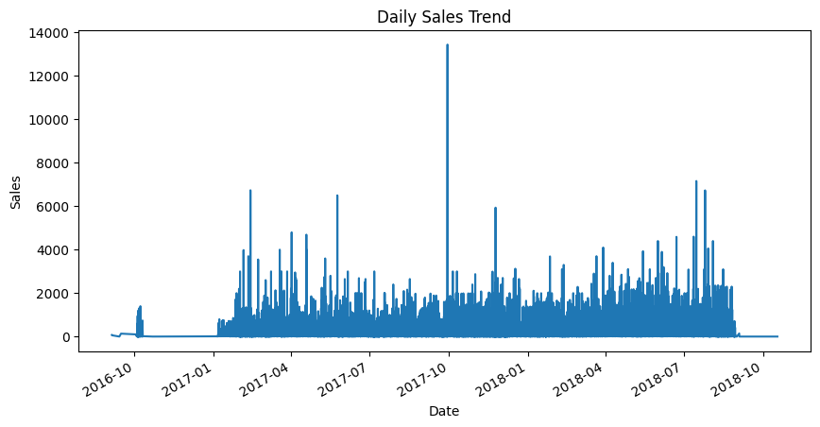
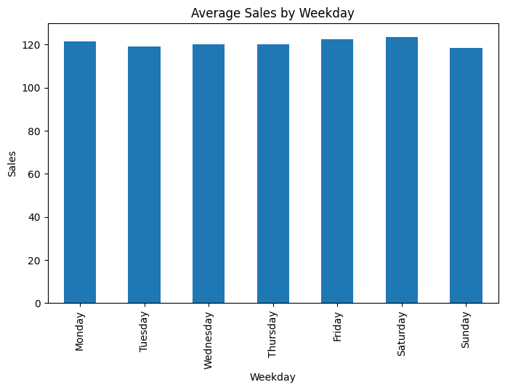
1. Temporal Analysis
Daily and Weekly Sales Trends:

Slide 17
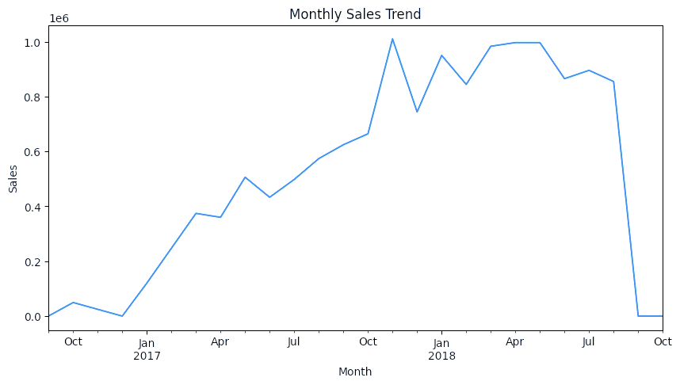
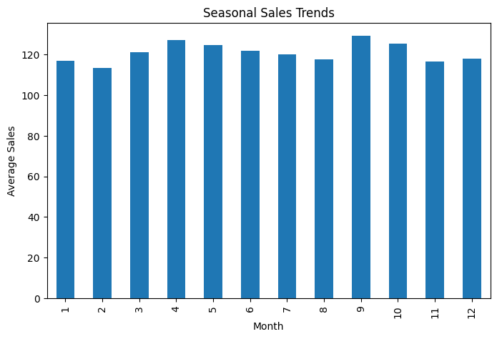
Monthly and Seasonal Sales Trends:

Slide 18
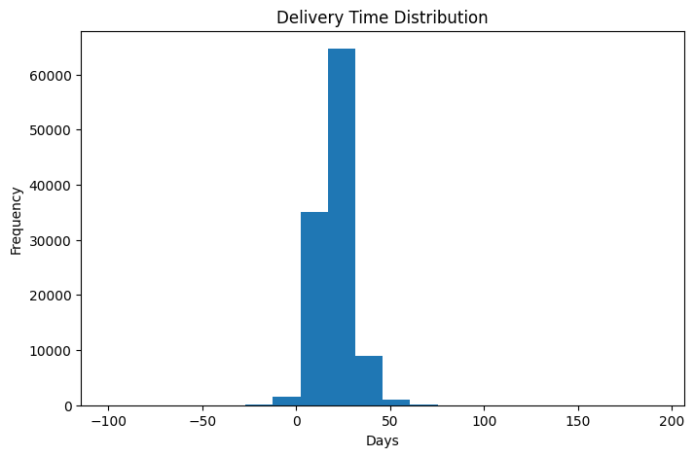
Delivery time distribution:

Slide 19
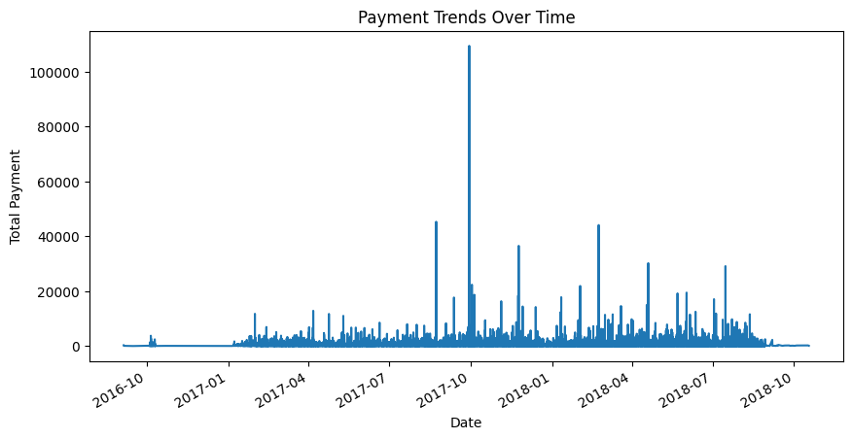
Payment patterns overtime:

Slide 20
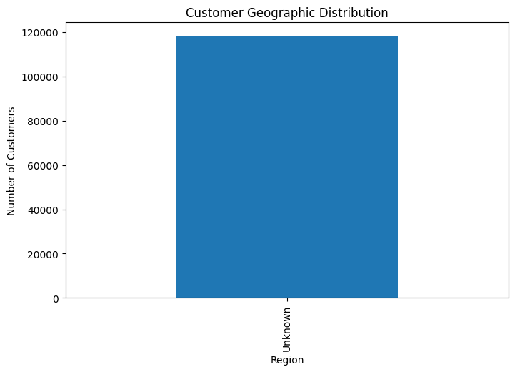
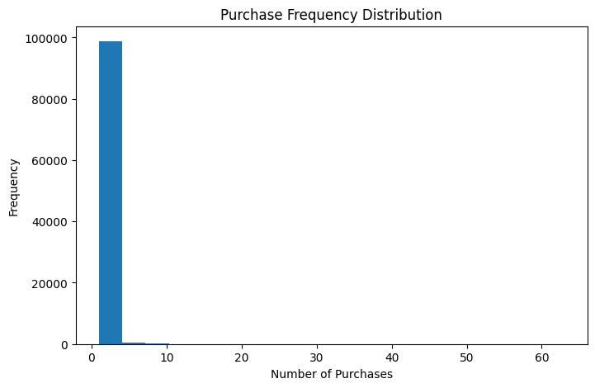
2. Customer analysis
customer geographic distribution and purchase frequency patterns:

Slide 21
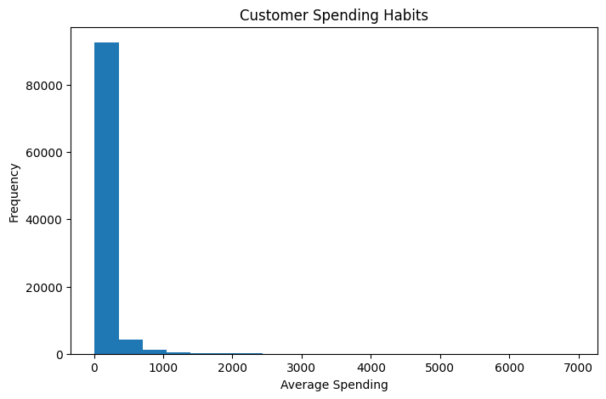
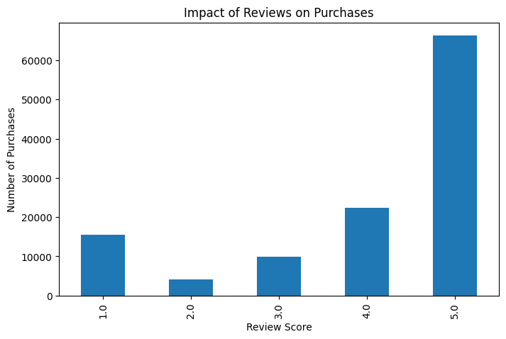
Customer spending habits and Impact of reviews on future purchases:

Slide 22
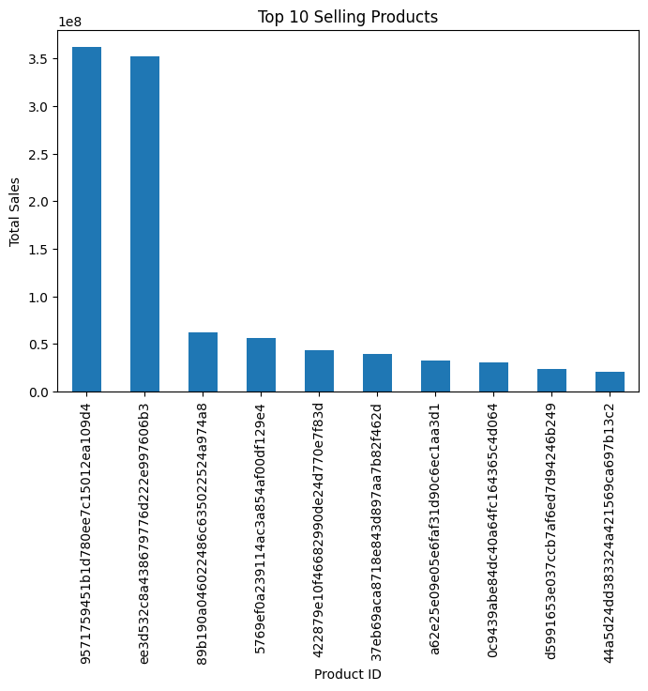
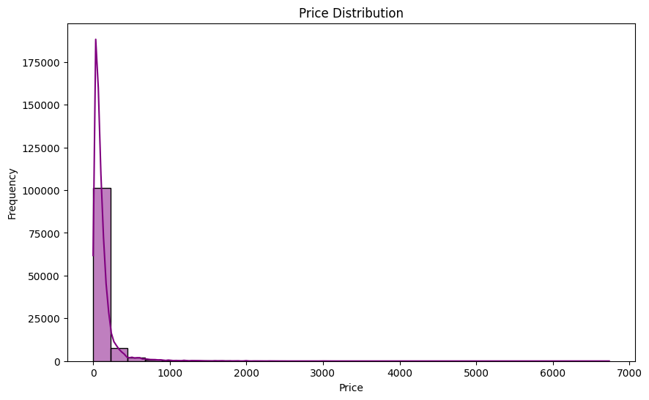
3. Product Analysis
Top-selling products and categories price distributions:

Slide 23
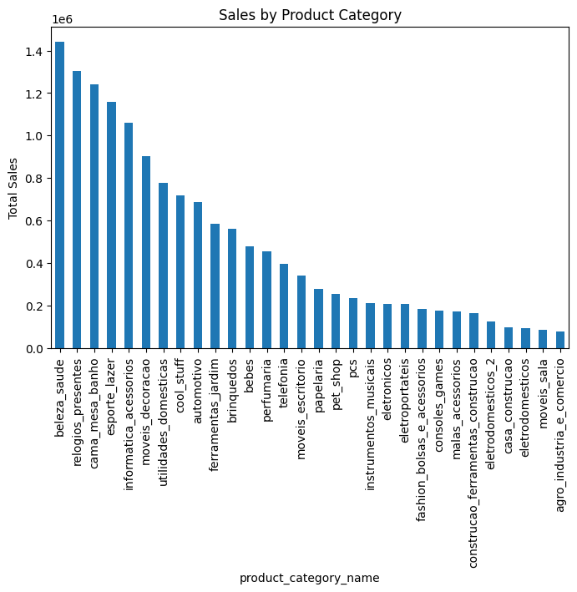
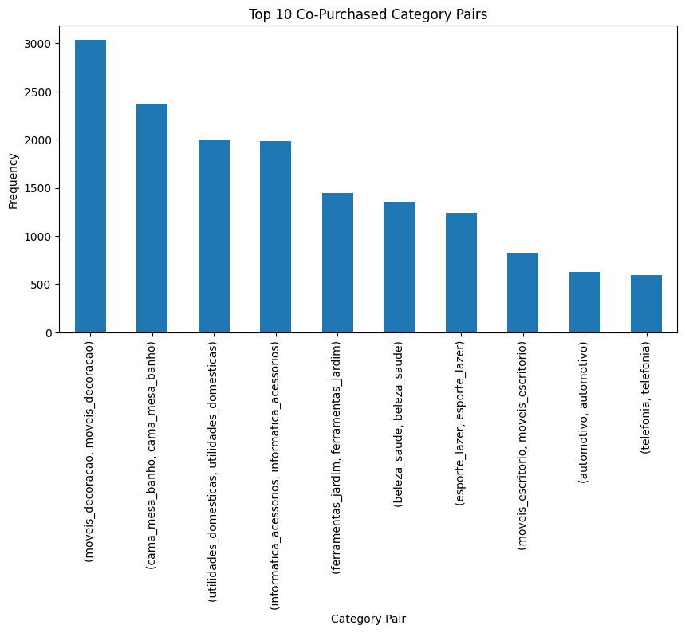
Product category relationships:

Slide 24
Phase 4: Statistical Analysis and Modeling
1. Predictive modeling:
Objective: Predict order amount based on key features.
Methodology:
Regression model development using linear regression.
Evaluated using R², RMSE, MAE.
Results:
R² Score: 0.0125
RMSE: 191.4
MAE: 94.3

Slide 25
Insights and Recommendations
Insights:
Sales Trends:
• Significant daily sales variability, influenced by promotions or holidays.
• Peaks in sales during weekends and holiday seasons, showing strong seasonality.
• Delivery delays correlate with lower customer satisfaction ratings.
Customer Behavior:
• Top 20% of customers contribute to 80% of the revenue (Pareto principle).
• Loyal customers with frequent purchases tend to leave positive reviews and spend more.
Product Insights:
• Categories like electronics and fashion show higher return rates, potentially due to quality or
expectation mismatches.
• Lower-priced items drive more purchases but generate lower profit margins.

Slide 26
Recommendations:
Sales Optimization:
• Align marketing campaigns with peak periods (holidays, weekends) to maximize sales.
• Monitor delivery times to enhance customer satisfaction and reduce negative reviews.
Customer Engagement:
• Implement loyalty programs to retain high-value customers.
• Personalize marketing efforts for repeat buyers to drive higher spending.
Product Strategy:
• Conduct quality checks and enhance product descriptions in high-return categories.
• Focus on promoting high-margin products to improve profitability.
Operational Efficiency:
• Streamline logistics to minimize delivery delays and returns.
• Analyze price-sensitive categories to optimize pricing strategies.

Slide 27
Conclusion
Summarized findings from data analysis and predictive modeling.
Delivered actionable recommendations for business growth.
Next Steps:
Refine predictive models.
Conduct deeper analysis on customer
lifetime value.

Slide 28
Thank you

